Slide 1
Report on CRUD operation
MONGODB
-Govardhan R S

Slide 2
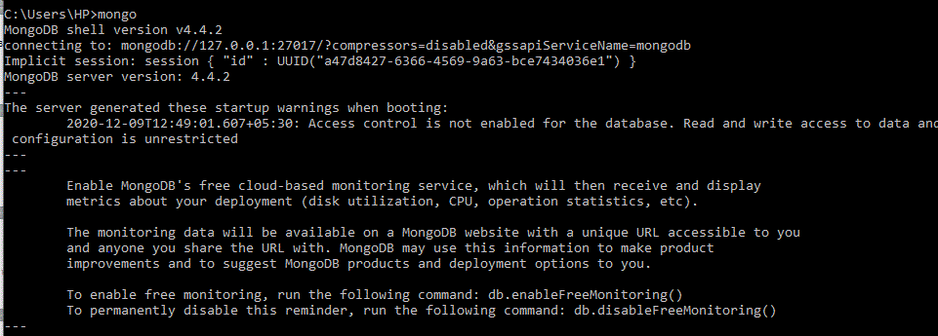
Mongo

Slide 3

Create DB

Slide 4
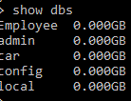
Show database

Slide 5

InsertOne

Slide 6
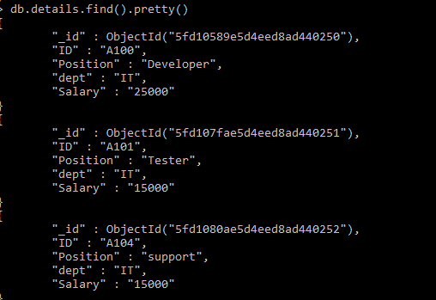
Show details

Slide 7
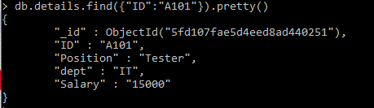
Find

Slide 8
UpdateOne

Slide 9
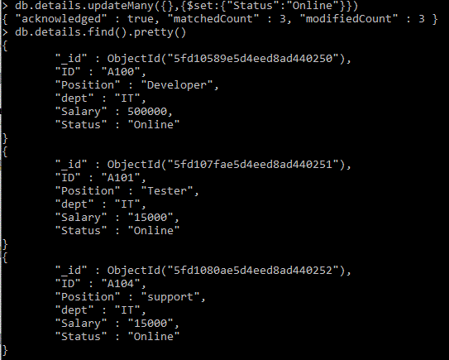
UpdateMany

Slide 10
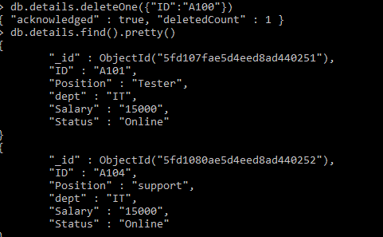
DeleteOne

Slide 11
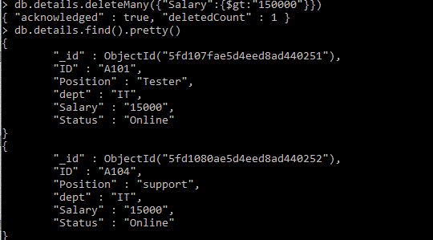
Delete Many

